Slide 1
Hotel Reservation System

Slide 2
AIM
The aim of this project are manage the information about the Hotel Reservation,
Customers and Hotel room Bookings.
This project is helpful for searching Hotel And available room with good facilities.

Slide 3
Introduction:
In this practical work we have made a website using the latest technologies for Hotel reservation, where a client can simply choose a date, the suitable price of a room, and then can submit his request simply. We used J2EE which consists of a set of APIs, services, and protocols that provide the functionality to develop multi-tiered web-based applications. It includes several technologies that extend the functionality of the Java SE APIs, such as Servlets, Connectors, Enterprise JavaBeans, in the core of J2EE we can find EJB’s which provide features such as declarative transactions and security via annotations.

Slide 4
Technologies Used:
The aim of this this project us to use the Java2EE framework to make a simple web site for hotel reservation. under it the roof of J2EE several other technologies were entailed, like Glassfish for server application, EJB which is the abbreviation of Enterprise java Beans, Servlets and also JSP’s, we have also resorted to JavaScript, CSS and Bootstrap to make a Good-looking web site, and since also we need a database, we used MYSQL database. Using all these technologies we handcrafted an awesome website.

Slide 5
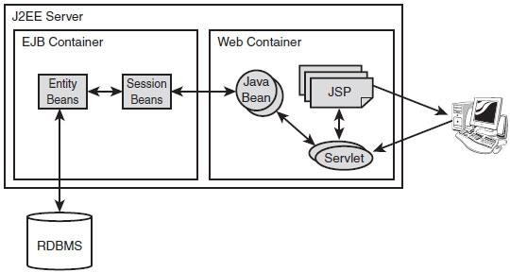

Slide 6
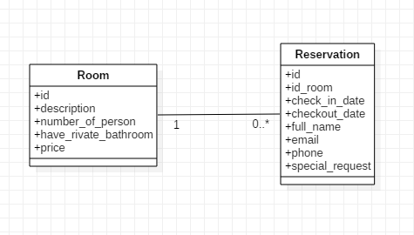
Database Design:
Our database contains two simple tables, which are Room and Reservation, the room table contains the available rooms in the hotel and the reservation contain the information of client reservation like his name, date and which room and so on. To access the database, we used the Façade of room and reservation.

Slide 7

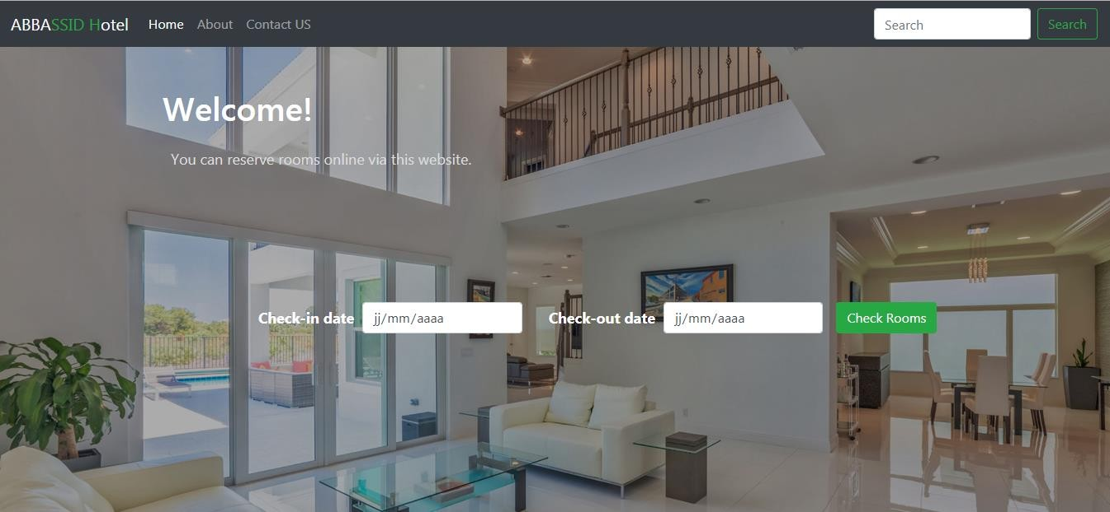
Screenshots: Here are some screen shots of our website:

Slide 8
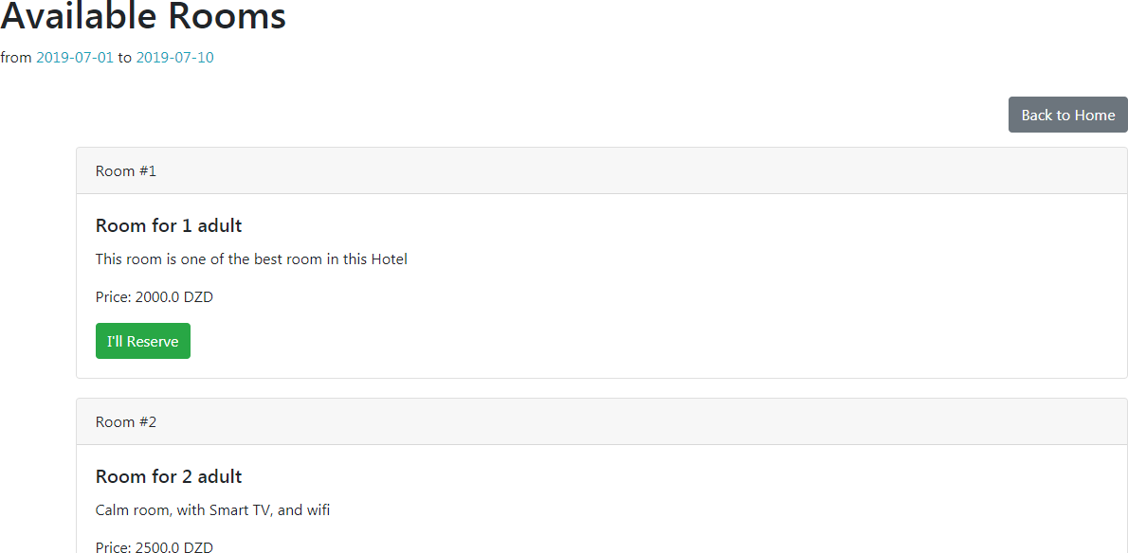


Slide 9
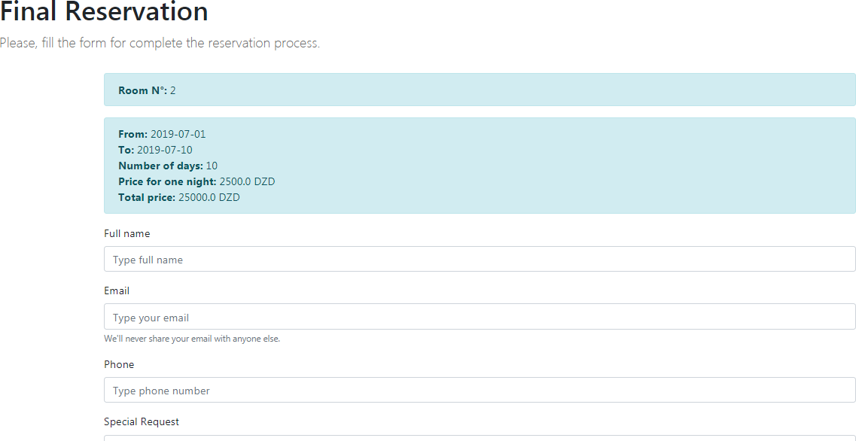

Slide 10
Conclusion:
Despite the mix of technologies used in this project which have run us into multiple problem we’ve succeed to manage them all together in order to produce a running website that used the latest technologies to make a great software architecture and to sheds light on the core components of J2EE API’s and Services.

Slide 11
BIBLIOGRAPHY AND REFERENCES
BIOGRAPHY AND REFERENCES:
Here are some websites, videos and books which we refered while building this project.
Video Reference:
Build and Deploy a React api and javascript lerning App and Master Redux Toolkit in One Video: https://www.youtube.com/watch?v=9DDX3US3kss&t=2222s&ab_channel=JavaScriptMastery
Web Reference:
CoinMarketCap: https://coinmarketcap.com/
w3schools: https://www.w3schools.com/
javaTpoint: https://www.javatpoint.com/
stack overflow: https://stackoverflow.com/

Slide 12
Thank you

